Slide 1
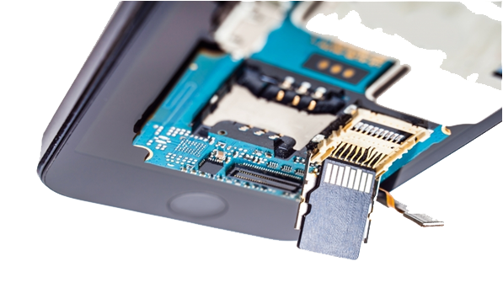
Mobile Phone Forensics
1

Slide 2

Introduction
“ With the advent of technology, the information that Mobile phones handles for users has grown multifold; they are not used just for calling purposes but rather play the role of digital assistant by managing emails, maintaining daily schedules, navigating the routes, they have become indispensible source of valuable data “
2

Slide 3
Levels of Data Extraction
Physical
Logical
Don’t requires Root
No Deleted data recovery
Manual
Done by People manually by digging in the phones
Requires Root
Deleted data Recoverable
HexDump ( JTag )
Done via a Service Cable to put phone in Serial Link
Procedure is Device Specific
Chip-Off
Physically removes the Flash, RAM, Cache and rebol to another reading platform
Micro Read
Data Extraction from broken Flash chips

Slide 4
Logical Data Extraction

Slide 5

Physical Data Extraction
A physical extraction from a mobile device shares the same basic concept as the physical forensic imaging of a computer hard drive. A physical extraction performs a bit-by-bit copy of the entire contents of the flash memory of a mobile device.

Slide 6



Physical Data Extraction
The Big picture of what we are going to do..
Bit by Bit copy of the physical flash Chip to a Disk Image file
Disk Image Mounting and File System Interpretation
Artifact Collection

Slide 7
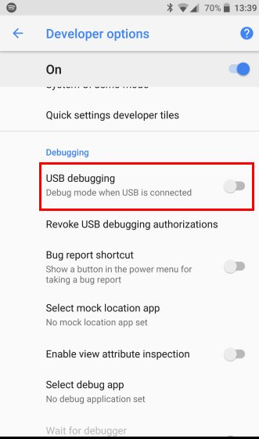
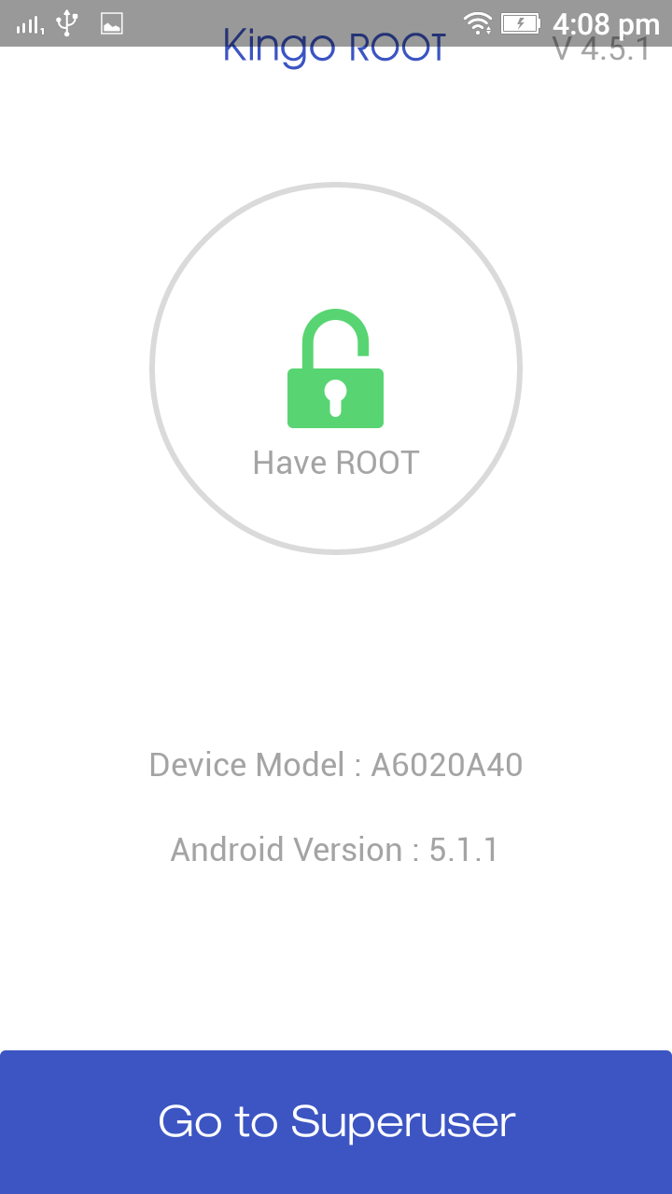
Physical Data Extraction
Method : DD imaging using ADB and NetCat
Some Must Haves –
Root level access to
the Phone
(Rooted Phone)
USB Debugging and
USB Authorization On

Slide 8

Physical Data Extraction
What dose Rooting Really means ??
It means you have root (administrator) access to your device, that is you can run sudo(superuser do [administrator]) commands in your device, the equivalent term for Apple devices id jailbreaking
It gives you privileges to modify the software code on the device or install other software that the manufacturer wouldn't normally allow you to
You can root either by installing the Superuser application or by flashing a custom ROM that includes root access

Slide 9
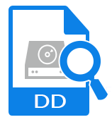
Physical Data Extraction
What is DD ??
Dd is a command-line utility for Unix and Unix-like operating systems whose primary purpose is to convert and copy files.
Dd is a tool that is often used in computer forensics because it is extremly low level and effecient at creating exact duplicates of hard drives. For this reason it is often the tool for which all other tools are compared to.

Slide 10

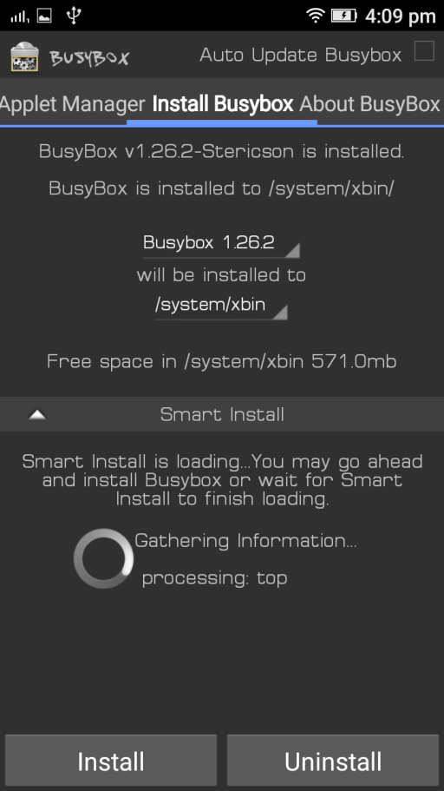
Physical Data Extraction
Method : DD imaging using ADB and NC
Tools can be used to–
Gaining Root to Phone Having Communication tools (NC)
KingoRoot BusyBox

Slide 11

Physical Data Extraction
Method : DD imaging using ADB and NC
WorkStation Setup –
Create a Working Directory (Folder) to keep everything Organised
ADB setup
NC(NetCat) setup
Download the kingoroot.apk and BusyBox.apk to be installed on the
Phone

Slide 12
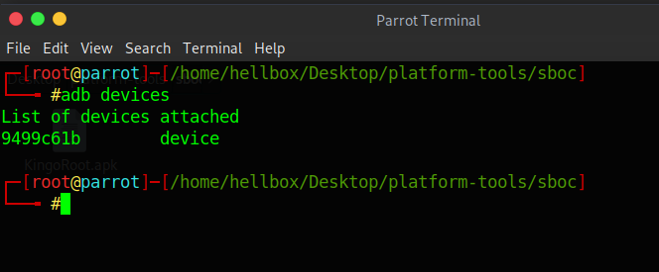
Physical Data Extraction
Method : DD imaging using ADB and NC
Let’s get Started !
Connect the Android device to the workstation via a Data cable
Open up the Terminal and type in ‘adb devices’ , and it should show the android device listed as Device

Slide 13
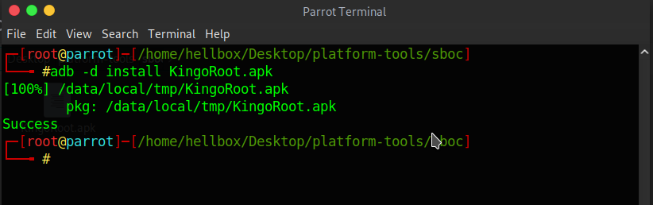
Physical Data Extraction
Method : DD imaging using ADB and NC
Now we need to install KingoRoot.apk in the phone to grant Root level Access to the phone for that type in ‘adb –d install KingoRoot.apk’ and hit enter
Also we need to install Busybox.apk after kingoroot is installed do the same for busybox by typing ‘adb –d install BusyBox.apk’

Slide 14
Physical Data Extraction
Method : DD imaging using ADB and NC
Stuff to do in the phone
press one click Root Press install button
KingoRoot BusyBox

Slide 15
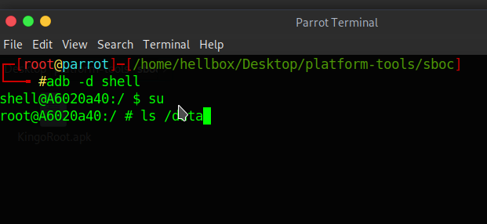
Physical Data Extraction
Method : DD imaging using ADB and NC
To take the shell of the phone type in ‘adb –d shell’ and hit enter
now to gain superUser(Root) access type in ‘su’ (Switch user) and hit enter

Slide 16
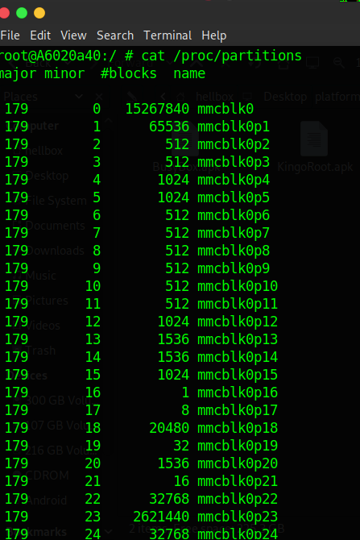
Physical Data Extraction
Method : DD imaging using ADB and NC
To explore the physical partitions type in ‘cat /proc/partitions’ and hit enter
Hear the one with the last index 0 or none are physical disks. in our case the physical disk is mmcblk0

Slide 17

Physical Data Extraction
Method : DD imaging using ADB and NC
Now we will create a Network Connection between the phone and our workstation to Dump data over it
open a new Terminal window and type in ‘adb forward tcp:8888 tcp:8888’ and hit enter, this will simply channel the adb traffic from tcp port 8888 to the workstation traffic on port 8888
Port
Forwarding

Slide 18
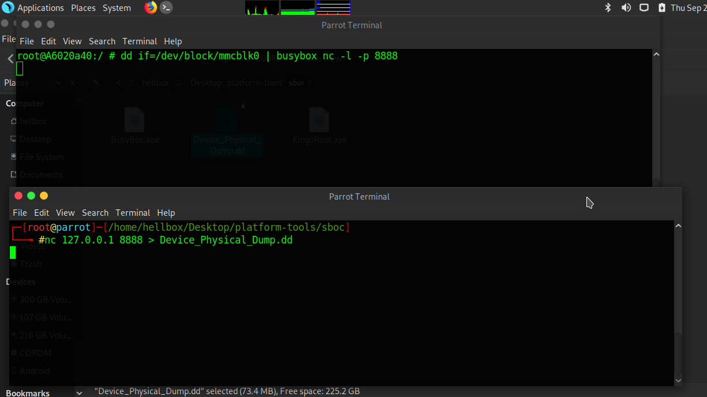
Physical Data Extraction
Method : DD imaging using ADB and NC
on the terminal with the phone shell on type ‘dd if=/dev/block/mmcblk0 | busybox nc –l –p 8888’ this will use dd(a commandline disk imaging tool) to create a .dd (raw format) image of the physical partition of the phone and pipes that to busybox which uses netcat to send that traffic to the workstation on port 8888

Slide 19
Physical Data Extraction
Method : DD imaging using ADB and NC
on the terminal with your system shell type in ‘nc 127.0.0.1 8888 > phone.dd’ this will use netcat to listen on port 8888 on the loopback address and generates a output file with a .dd extension

Slide 20

Data Analysis

Slide 21


Data Analysis
In order to mount and interpret the .dd image file we will use a hex editor which can interpret File Systems and carve out file hierarchy in our case we will use AccessData FTK Imager.
FTK will let us :
Mount & Interpret image file
Go through the hierarchy to explore folders and collect artifacts manually
Search based on file signatures(header)

Slide 22
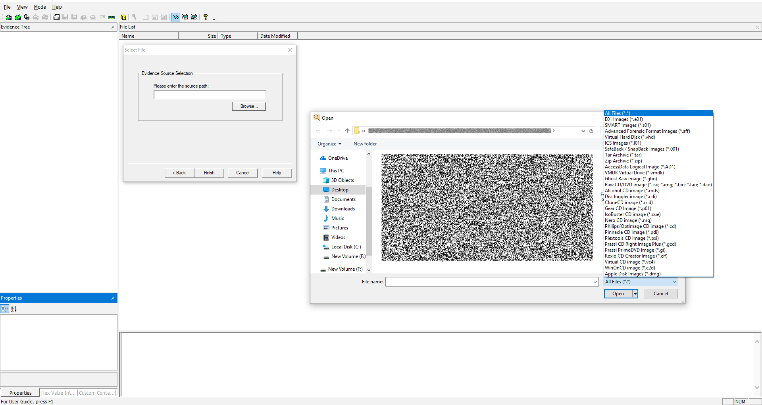
Data Analysis
In FTK open menu we can see the option of opening all format disk image files

Slide 23
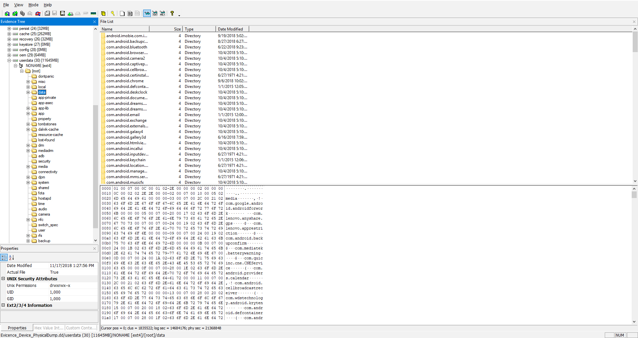
Data Analysis
Once the disk image file is opened you can easily go through Directories to explore

Slide 24
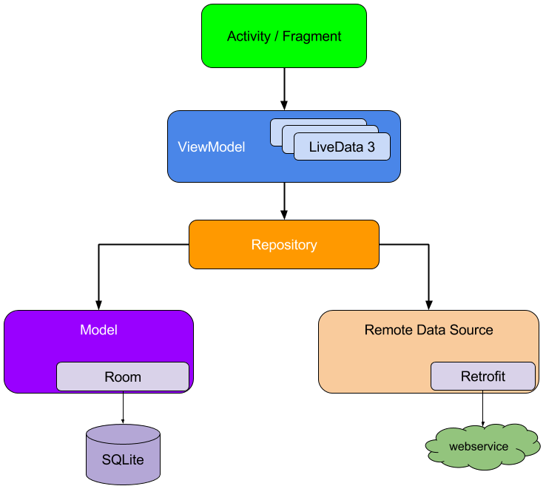

Data Analysis
In what form does Android keep its Data ??
There are 2 basic models to store data :
On the Device in the form of database files (.db) ex: Whatsapp
On the cloud by accessing the desired web service ex: facebook
Local
Network

Slide 25

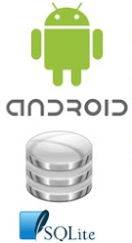
Data Analysis
What is SQLite ??
SQLite is a relational database management system contained in a C programming library.
In contrast to many other database management systems.
SQLite is not a client–server database engine. Rather, it is embedded into the end program.
Why SQLite ??
SQLite is very well-suited as a device-resident data manager.
It is an application library and not a client-server database, making it very flexible for applications to use.
As an app-resident library, it has no notion of "installation", it doesn't need to be configured or connected to, and its data is stored in a simple file that is completely in the control of the application.

Slide 26

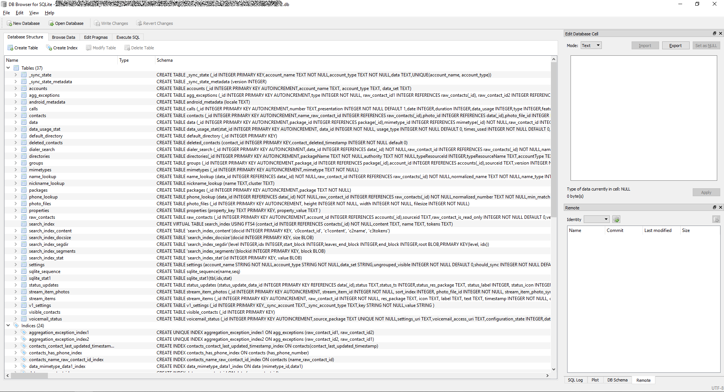
Data Analysis
db browser for sqlite

Slide 27


Data Analysis
Android File systems
There are 3 basic kinds of android File Systems :
Flash Memory Android File System
Media-based Android File System
Pseudo File Systems

Slide 28

Data Analysis
Flash Memory Android File System
exFAT
Originally created by Microsoft for flash memory, the exFAT file system is not a part of the standard Linux kernel
It stands for Extended File Allocation Table
F2FS
F2FS stands for Flash-Friendly File System, which is an Open Source Linux file system
Samsung uses it since 2012
JFFS2
It stands for the Journal Flash File System version 2
This is the default flash file system for the Android Open Source Project kernels
This is there since the Android Ice Cream Sandwich OS was released.
YAFFS2
It stands for Yet Another Flash File System version 2
Rarely found in Android smartphones

Slide 29

Data Analysis
Media-based Android File System
EXT2/EXT3/EXT4
Ext, which stands for the EXTended file systems, are the standards for the Linux file system
latest of them all is EXT4, which has now been replacing the YAFFS2 and the JFFS2 file systems on Android smartphones
MSDOS
Microsoft Disk Operating System
It helps FAT 12, FAT 16 and FAT 32 file systems to run
VFAT
An extension to the aforementioned FAT 12, FAT 16 and FAT 32 file systems, the VFAT is a kernel module seen alongside the MSDOS module
External SD cards that help expand the storage space are formatted using VFAT

Slide 30
Data Analysis
Pseudo File Systems
CGroup
Cgroup stands for Control Group, Its a pseudo file system which allows access and meaning to various kernel parameters
Cgroups are very important for the Android File System as the Android OS makes use of these control groups for user accounting and CPU Control
Rootfs
Rootfs acts as the mount point, and it is a minimal file system.
It is located at the mount point “/”.
Procfs
Usually found mounted at the /proc directory. The procfs file system has files which showcase the live kernel data
Sometimes this file system also reflects a number of kernel data structure
These number directories are reflective of the process IDs for all the currently running tasks
Sysfs
mounted on the /sys directory. The sysfs file system helps the kernel identify the devices
the kernel builds an object in sys/module/ directory
Tmpfs
A temporary file system, tmpfs is usually mounted on /dev directory.
Data on this is lost when the device is rebooted.

Slide 31
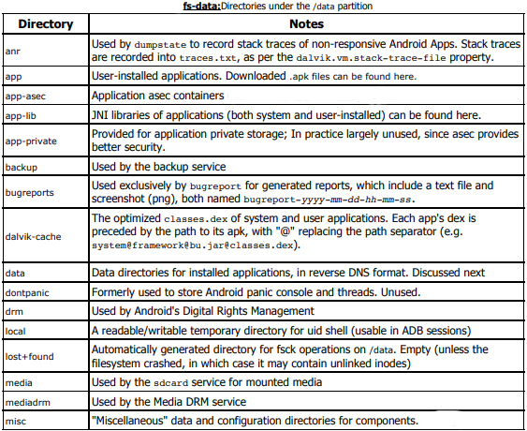
Data Analysis
Critical artifacts locations :-

Slide 32
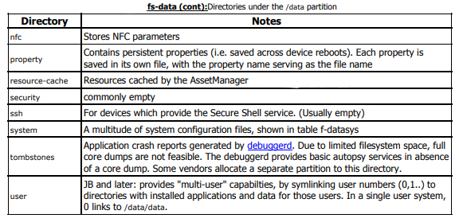
Data Analysis
Critical artifacts locations :-

Slide 33
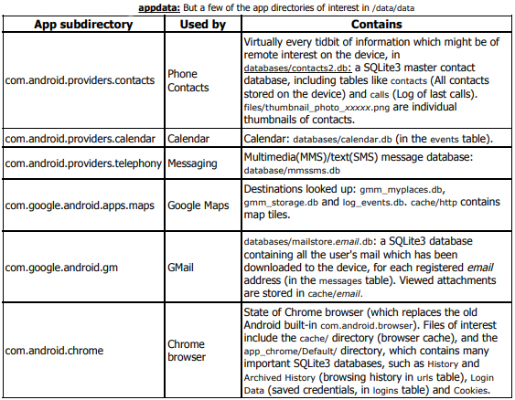
Data Analysis
Critical artifacts locations :-

Slide 34
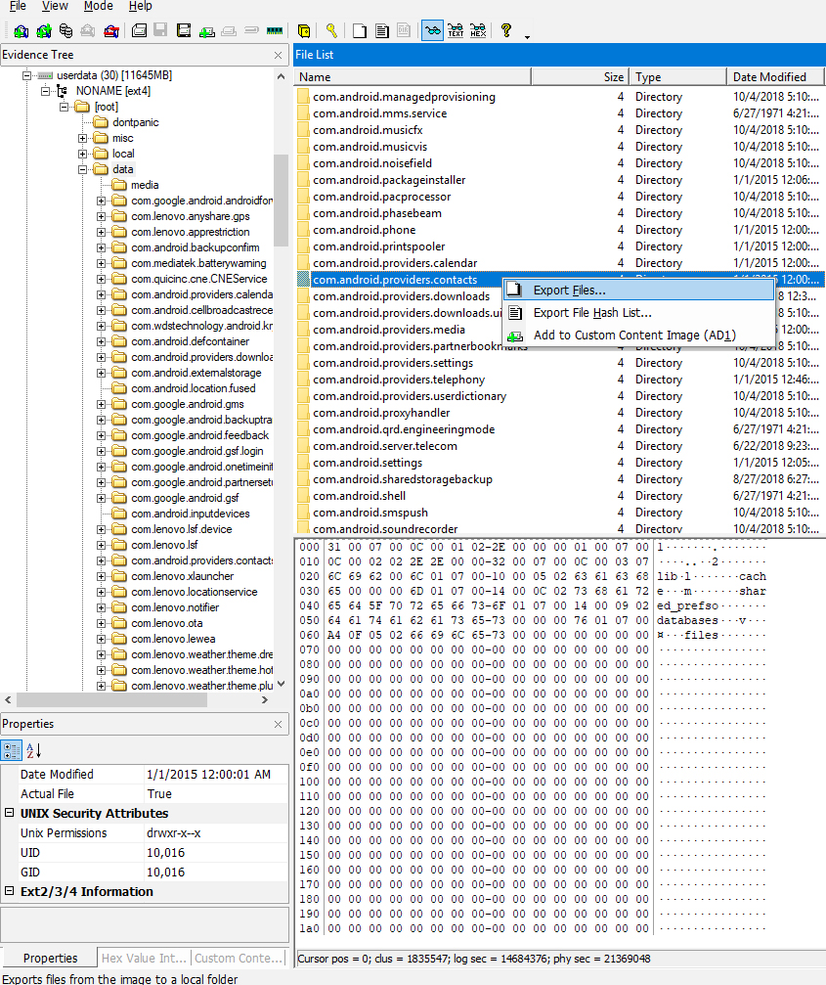
Data Analysis
Com.android.providers.contacts :: Phone Contacts
FTK imager lets you browse through the directories and select the ones relevent to you
Once you find what to take, you can export the selected file or folder by right clicking and exporting it to your local system
Now in this directory the phone contacts database should be found
Go ahead and try to find the .db extension file in the exported folder
This is the file we will open in the db browser to see the contacts

Slide 35
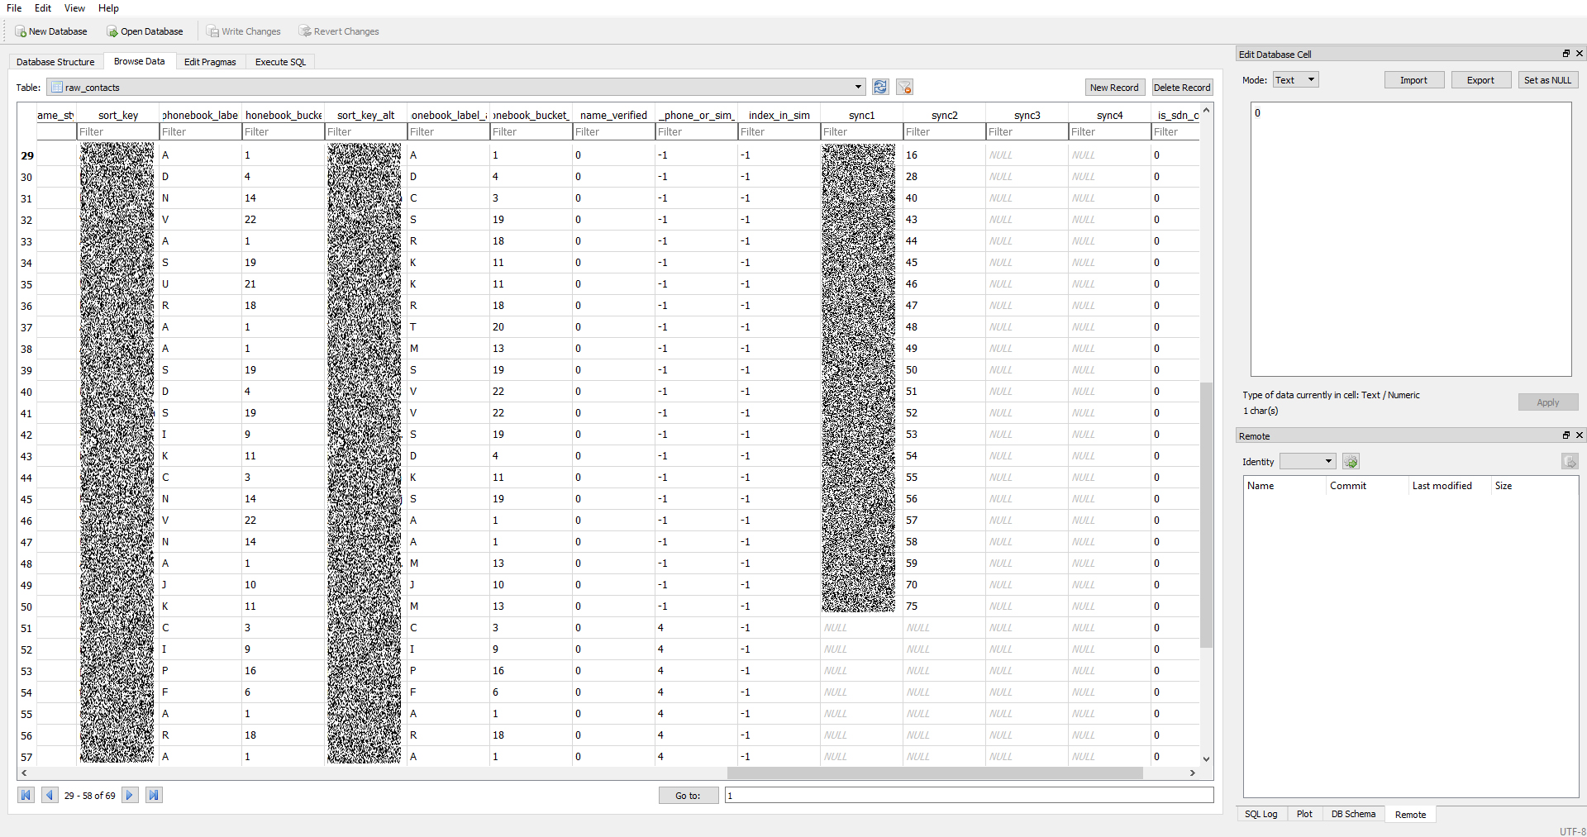
Data Analysis
Contacts2.db is the database file hear and we opened it in db Browser
And its the same story for most DB files...

Slide 36
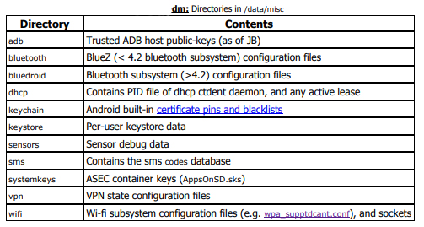
Data Analysis
Critical artifacts locations :-

Slide 37
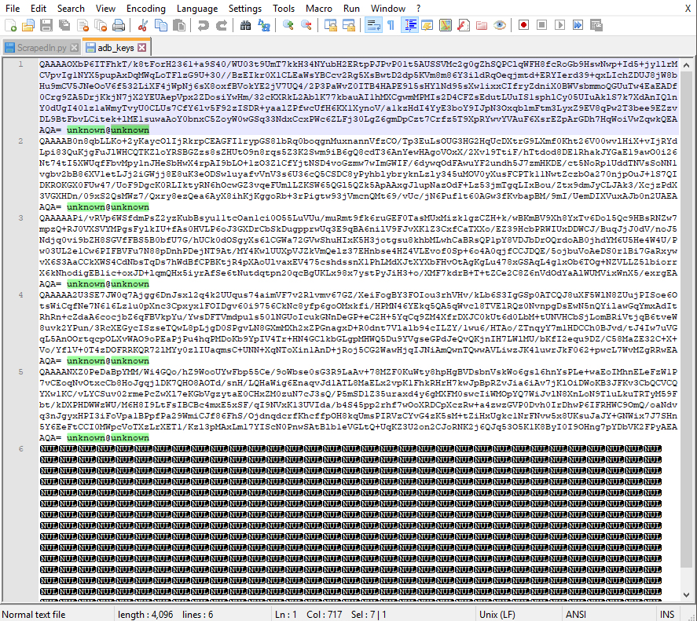
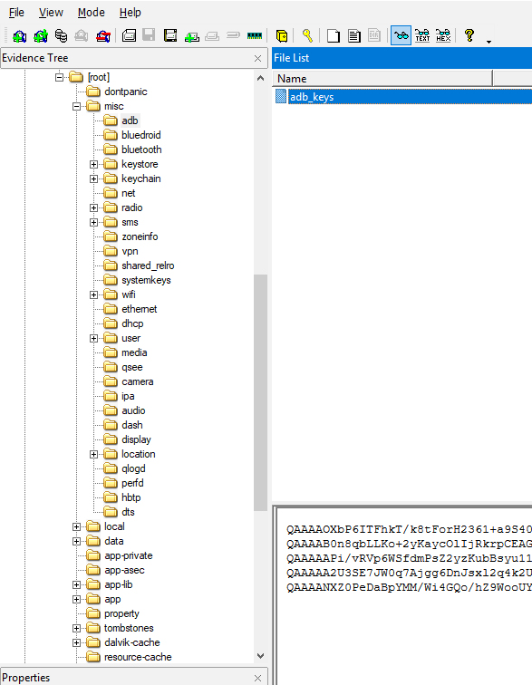
Data Analysis
Other files like ADB Host keys are stored in form of files which you can try interpreting on a normal text editor (our case Notepad++)

Slide 38
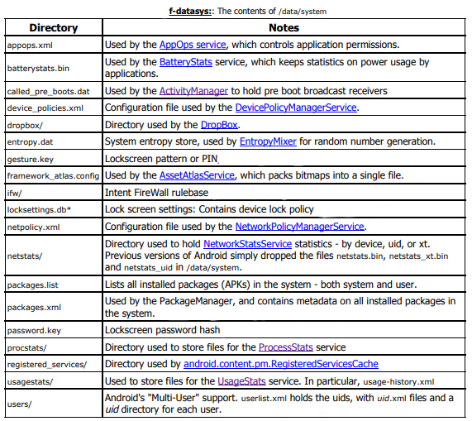
Data Analysis
Critical artifacts locations :-

Slide 39


File Carving
Open source Tools
The Sleuth Kit is a library and collection of command line tools that allow you to investigate disk images. The core functionality of TSK allows you to analyze volume and file system data.
Autopsy is a digital forensics platform and graphical interface to The Sleuth Kit and other digital forensics tools. It is used by law enforcement, military, and corporate examiners to investigate what happened on a computer. You can even use it to recover photos from your camera's memory card.

Slide 40
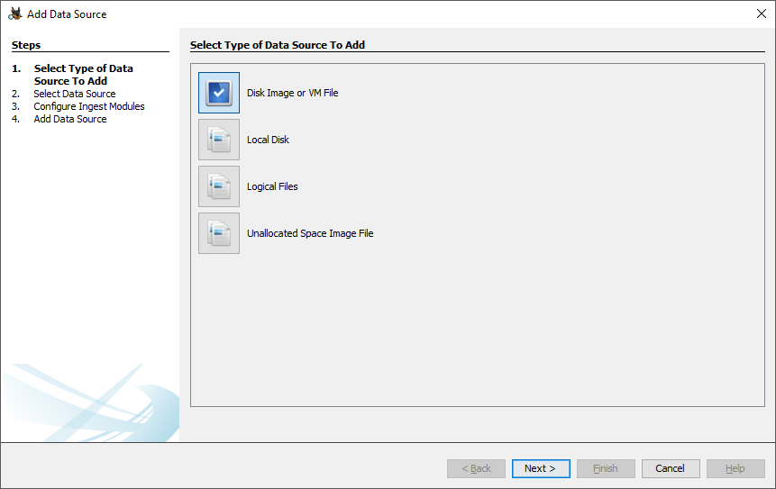
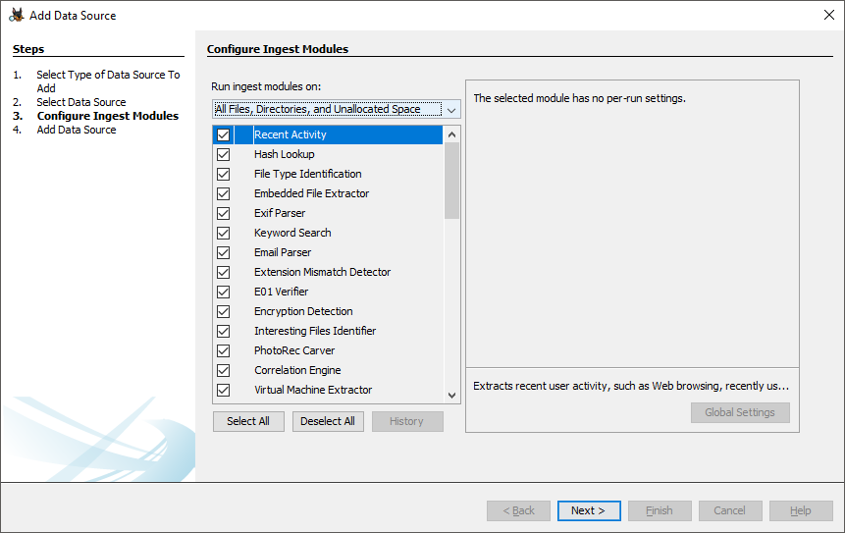
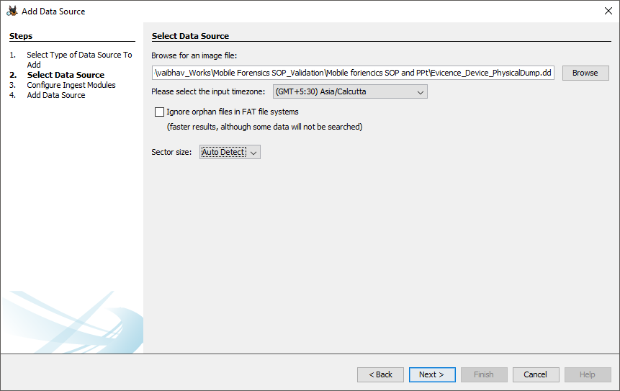
File Carving
Autopsy
Firstly we will create a new case and add Data Sources, In our case it’s a Disk Image file

Slide 41
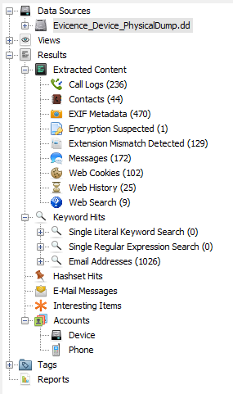
File Carving
Autopsy
Once the process is completed you should see a more user Friendly interface of carved out Locations like:
Call Logs
Messages
Web history
Contacts
Emails
Images
Also it provides a Directory Hierarchy view if you wish to find something manually

Slide 42
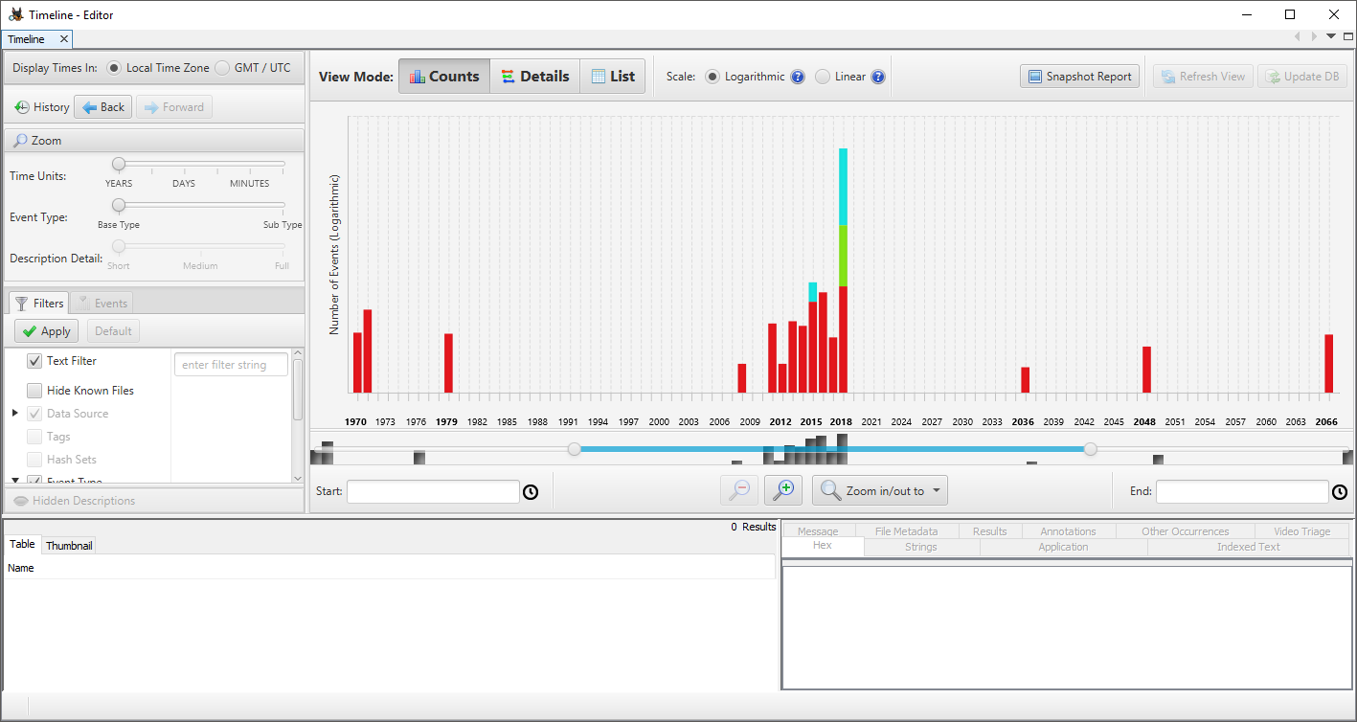
File Carving
Autopsy
Timeline View lets you search on a specific Timeline rather than manually digging the data based off their timestamps.

Slide 43
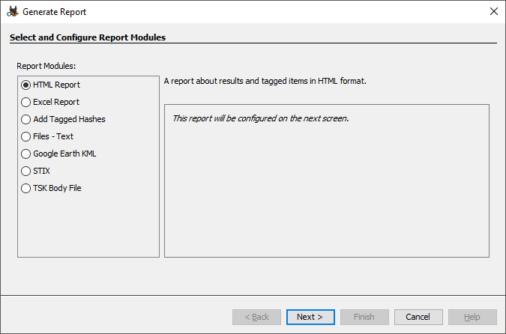
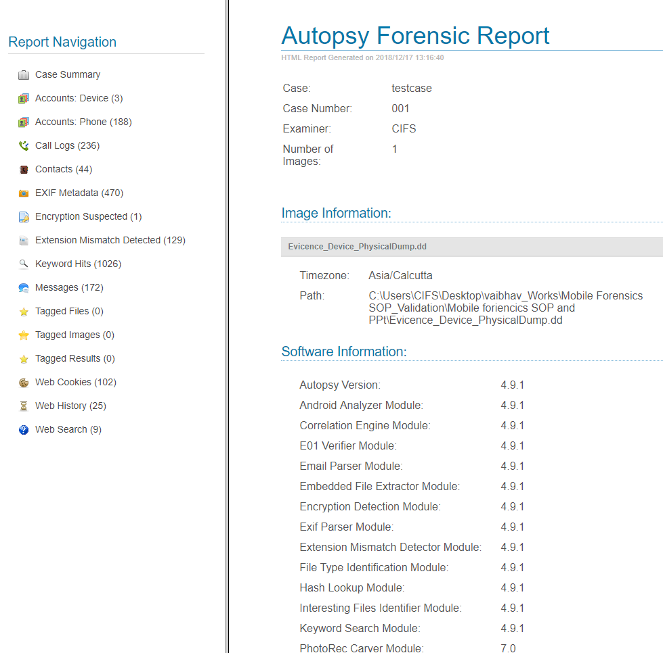
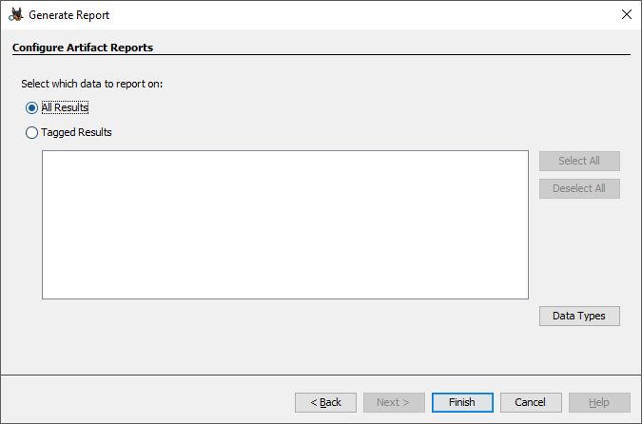
File Carving
Autopsy
Autopsy provides a option to Generate Reports in many different formats and you can filter out the outputs based on tagging

Slide 44
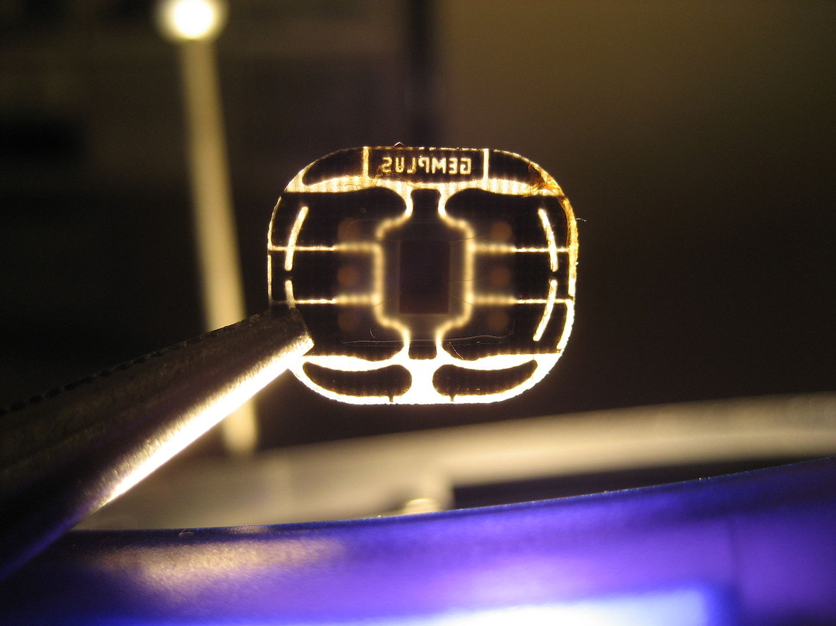
Sim card Data analysis
Understanding the SimCard

Slide 45
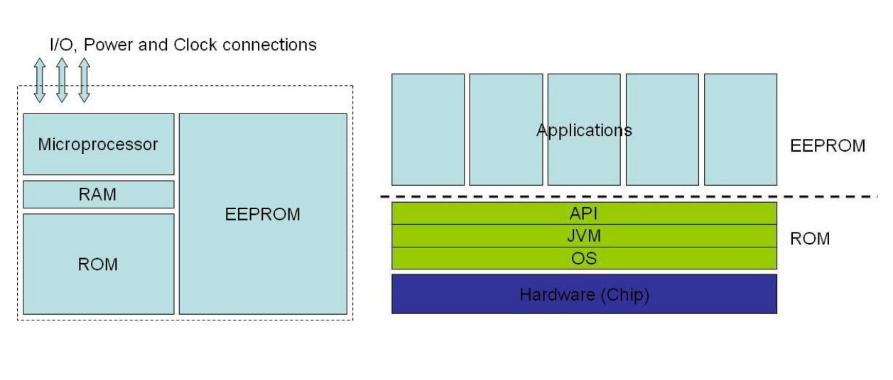
Sim card Data analysis
Technical Details of SIM Card
SIM cards physical dimension follows ISO/IEC 7816 standard, managed jointly by the ISO and IEC. SIM card also contains its own:
• Microprocessor (CPU)
• Program memory (ROM)
• Working memory (RAM)
• Data memory (EPROM or E2PROM)
• Serial communication module
Logical Structure of a SIM card

Slide 46
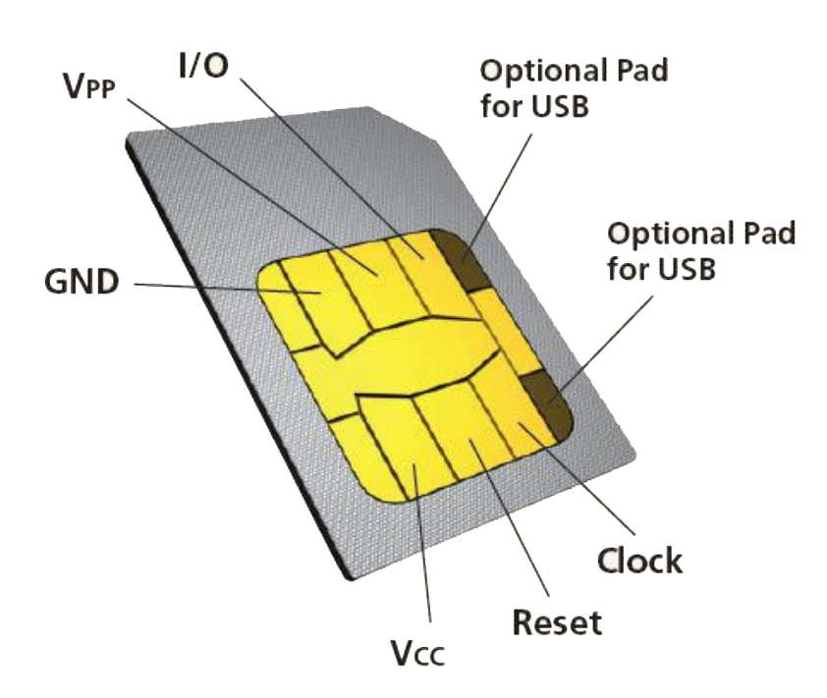
Sim card Data analysis
SIM Card Connection pads
SIM data - Нis accesses the digital data being stored on a SIM memory.
SIM clock - Нis is a clock frequency signal that synchronizes to the digital data to create data signal for transferring or sending and receiving data information.
SIM reset - Нis is a frequency signal that is meant to trigger or reset all the synchronization processes.
VSIM B+ supply voltage – It is a power supply voltage which is used to activate the circuit of a SIM card.
SIM ground - A ground line voltage.
The sixth one is not connected.

Slide 47
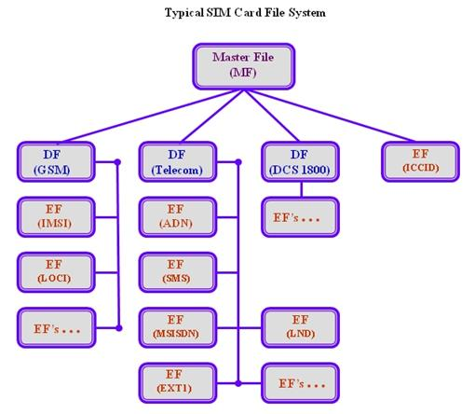
Sim card Data analysis
SIM Card File System
The file system of a SIM card is organized in a hierarchical tree structure,
Master File (MF) – Master file is the root of the file system organization. It contains all the dedicated and elementary files.
Dedicated File (DF) – Dedicated files are subordinate directories to the master file that contain dedicated and elementary files.
Elementary File (EF) – These are files that contain various types of formatted data structures, which can be a sequence of data bytes, a sequence of fixed size records, or a fixed set of fixed size records used cyclically

Slide 48
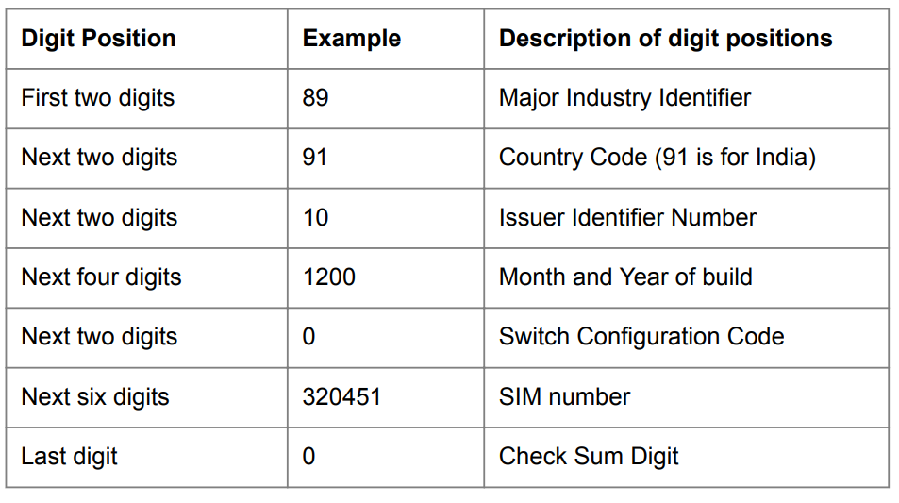
Sim card Data analysis
Some must knows.
ICCID
Every SIM is identified internationally by its ICC-ID (Integrated Circuit Card ID)
The ICC-IDs are stored in the SIM card and they may even be engraved or printed on the SIM card’s body during a process which is called personalization
The number is generally up to 18 digits long with an addition of a single “check digit” that is used for error detection.
This single digit allows us to detect mistyped digits, an input error of digits or a permutation of two successive digits. This digit is calculated with the use of the Luhn algorithm
Example 89 91 10 1200 00 320451 0

Slide 49

Sim card Data analysis
Some must knows.
Luhn algorithm
If just a sum is used both strings "ABCD" and "ABDC" would yield the same checksum ("A"+"B"+"C"+"D"), so simple swap errors could happen unnoticed.
However, taking parity into concideration, "ABCD" and "ABDC" will become (2"A"+"B"+2"C"+"D") and (2"A"+"B"+"C"+2"D") respectively, which are (likely) different numbers, so in this way we could detect if two characters were inadvertly swapped.

Slide 50

Sim card Data analysis
Some must knows.
IMSI
A fifteen-digit long number, the International Mobile Subscriber Identifier is primarily used for signaling and messaging over a GSM network.
Similar to the ICCID, the IMSI is structured as follows: three-digits for the Mobile County Code (MCC), plus two to three digits for the Mobile Network Code (MNC), and the rest is an allocated sequential serial number that pinpoints the Mobile Subscriber Identity Number (MSIN)
Ex :
424 reflects the Mobile Country Code, in this case, the United Arab Emirates.
02 refers to the Mobile Network Code, which is the Emirates Telecommunications Corporation (Etisalat).
The remainder of the digits signify the Mobile Subscriber Identification Number (1445434857).

Slide 51
Sim card Data analysis
Some must knows.
MSISDN
Its maximum size is fifteen digits, the Mobile Station International Subscriber Directory Number is assigned for a subscriber to receive calls but is not signaled to or from a device.
A subscriber can have multiple MSISDNs, and each one refers to the full subscriber phone number, including the country code.
MSISDN consists of :
Country Code (CC – up to three-digits)
National Destination Code (NDC – up to 3 digits)
Subscriber Number (SN – up to 10 digits)
MSIDSN is an optional elementary file (i.e., Optional EF does not need to be stored on the SIM card itself), which differentiates it from both ICCID and IMSI (which are mandatory fields).
Own Dialing Number is a similar service that allows mobile users to inquire about their telephone numbers by dialing a specific numeric code.

Slide 52

Sim card Data analysis
Some must knows.
MSISDN
Ex :
971 represents the Country Code (United Arab Emirates)
50 identifies the National Destination Code (Mobile Phone by Etisalat)
5682881 refers to the Subscriber Number

Slide 53
Sim card Data analysis
Some must knows.
SPN (Service Provider Name) and
SDN (Service Dialing Numbers)
They are also optional elementary files.
They convey the name of the GSM Network Service Provider and the unique services it provides (i.e., customer care number).
As per the standard, if a network provider chooses a field to be of variable length, then remaining digits should be set to hexadecimal digit “F.”

Slide 54
Sim card Data analysis
Some must knows.
TMSI
Temporary Mobile Subscriber Identity is a temporary identifier that is exchanged between the mobile phone and the local network nearby
The TMSI is automatically updated when the subscriber moves between geographical locations to avoid signal fade, thus providing the mobility freedom supported by GSM cellular networks.
ADN
Abbreviated Dialing Numbers refers to the contacts list saved by the subscriber on the SIM card.
LND (Last Numbers Dialed) is associated with the most recent number the subscriber called. Limited by the number of contacts it can contain due to its small capacity, a SIM can store additional digits from ADN and LND into the dialing extensions EXT1 and EXT2 elementary fields

Slide 55
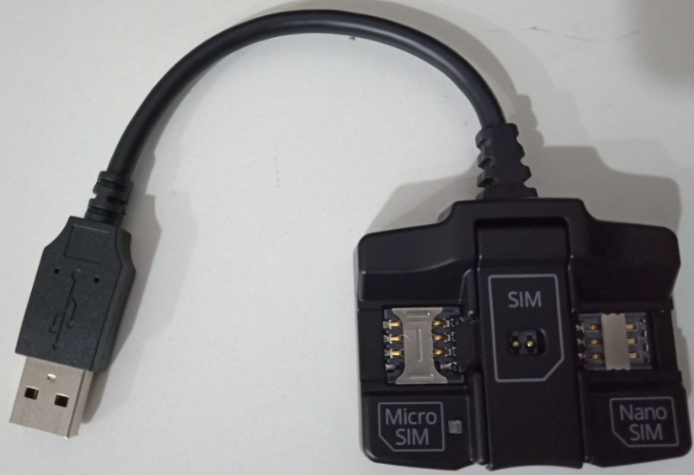
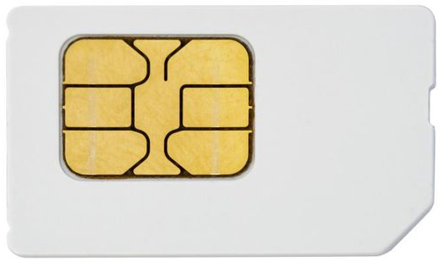
Sim card Data Extraction
Requirements :
Hardware device to read a SIM card (sim card reader)
Tool to read data from the sim (in our case Ufed 4PC)
Tool to analyse the data extracted from the SIM (in our case UFED physical Analyser)
Ufed SIM card reader
SIM card to Read

Slide 56
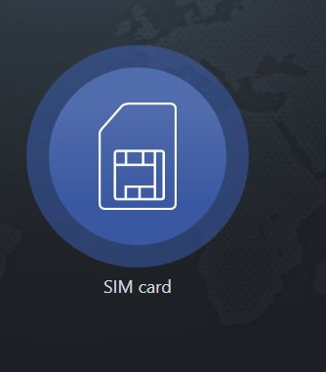
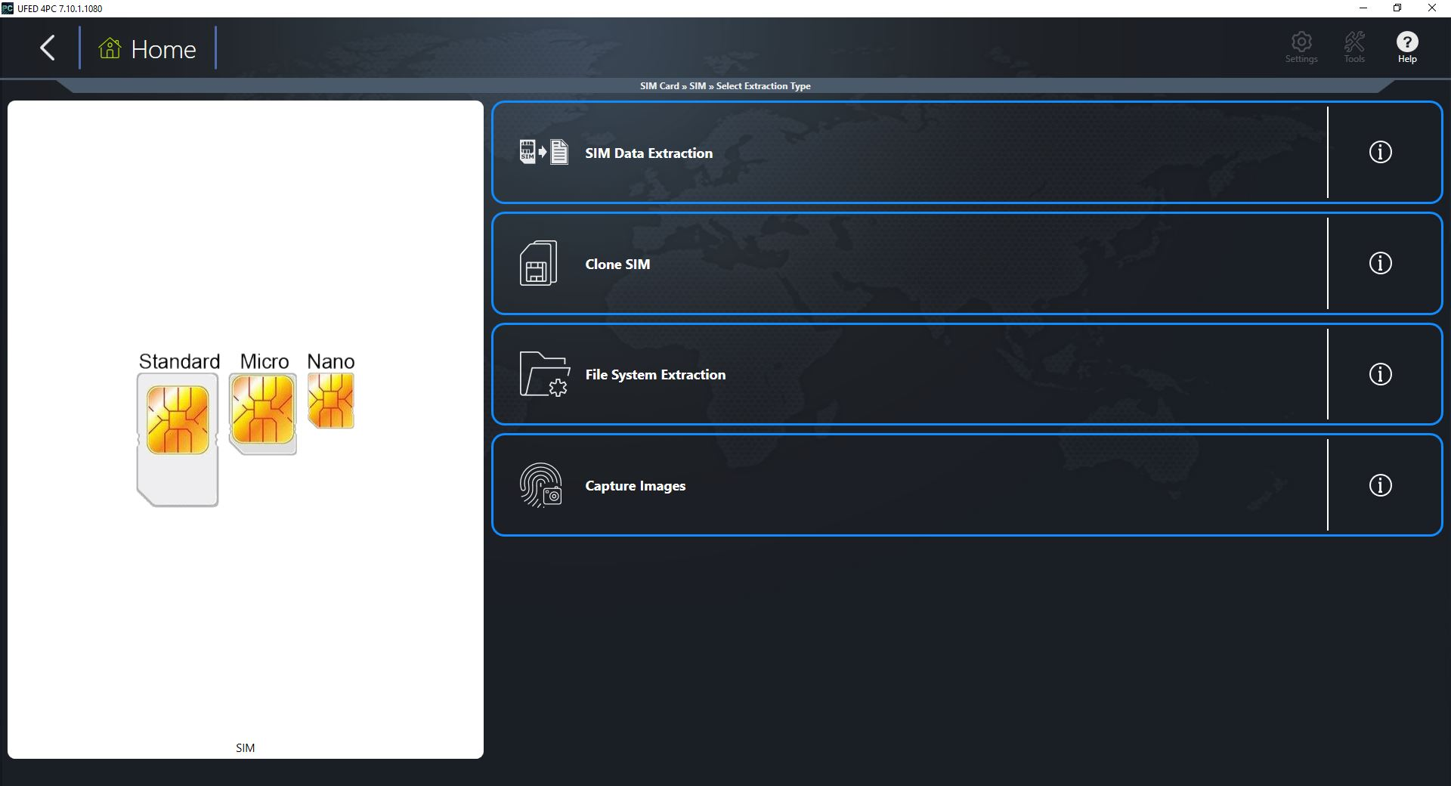
Sim card Data Extraction
Firstly we will just insert the sim in the sim reader and connet the reader to the workstation
Then we will start Ufed 4PC and open up the SIM card option
And select our process which in our case is Sim Data Extraction

Slide 57
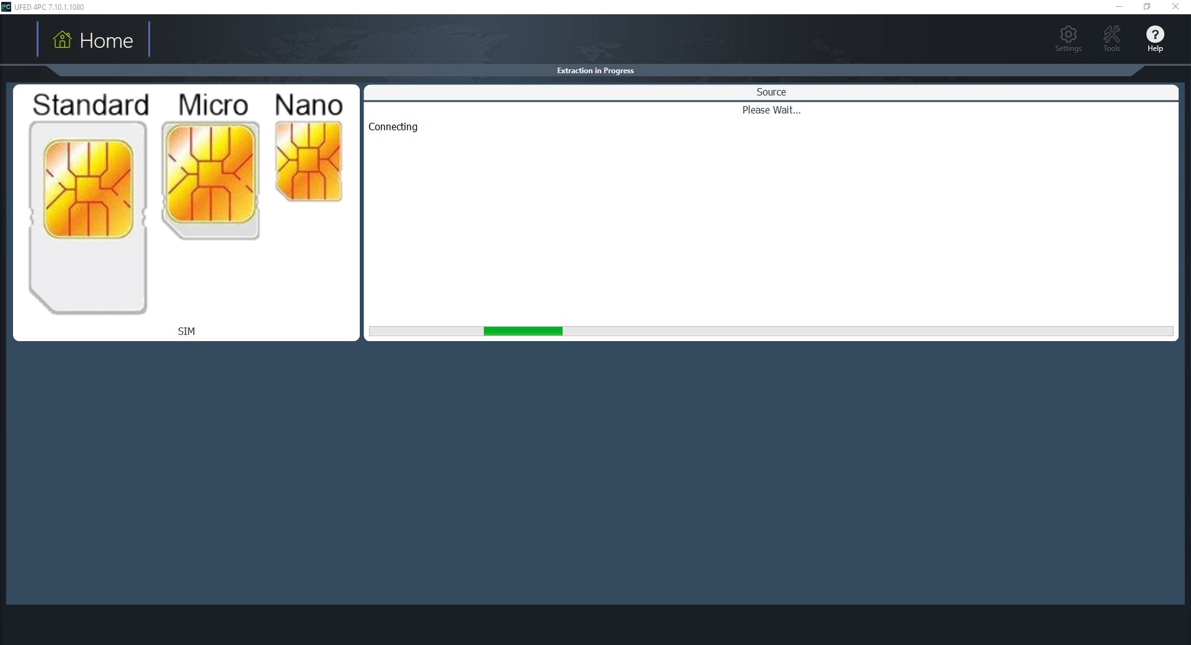
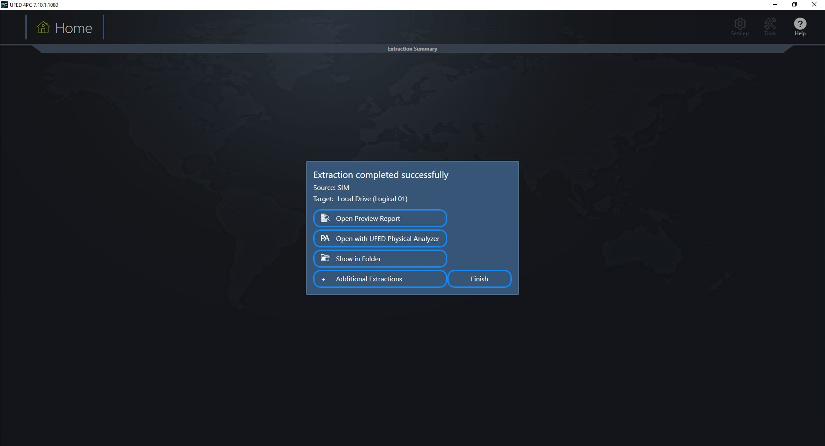
Sim card Data Extraction
Wait for the extraction to be completed.
Once its done we can analyse it in the Ufed physical Analyser

Slide 58
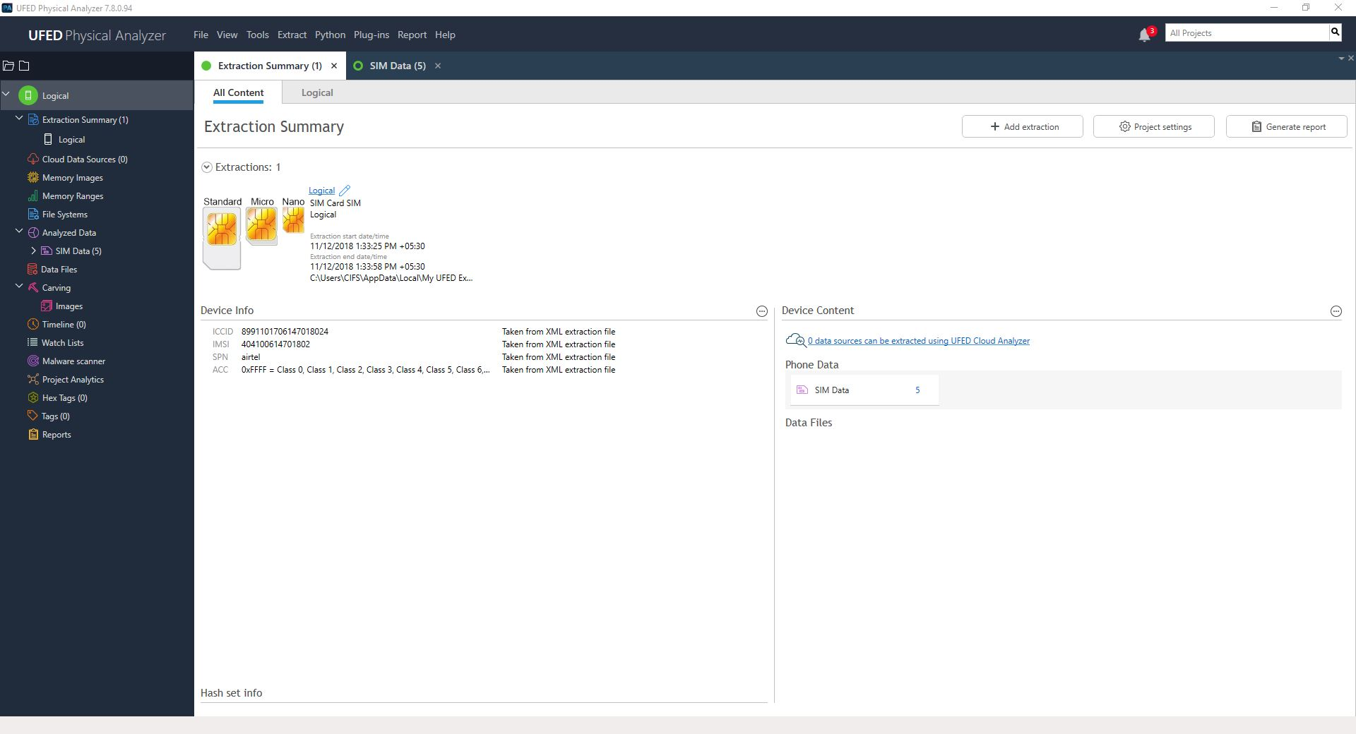
Sim card Data Extraction
Data being analysed in the Ufed Physical Analyser

Slide 59
Memory card extraction
We Will use DD the command line utility tool to create a physical dump of the Memory card and then we will analyse it in FTK imager
ls /dev/sdc*
dd if=/dev/sdc of=sdimage.img bs=4M

